Slide 1
Design and implementation of an automatic 4 dof robot arm picker
Munyakabera jean claude | 2019040146006
Ndizihiwe jean paul |2019040146003
Abigaba peter | 2019040146005
GUTEMA MISGANA DERIBACHEW | 2019040146010

Slide 2
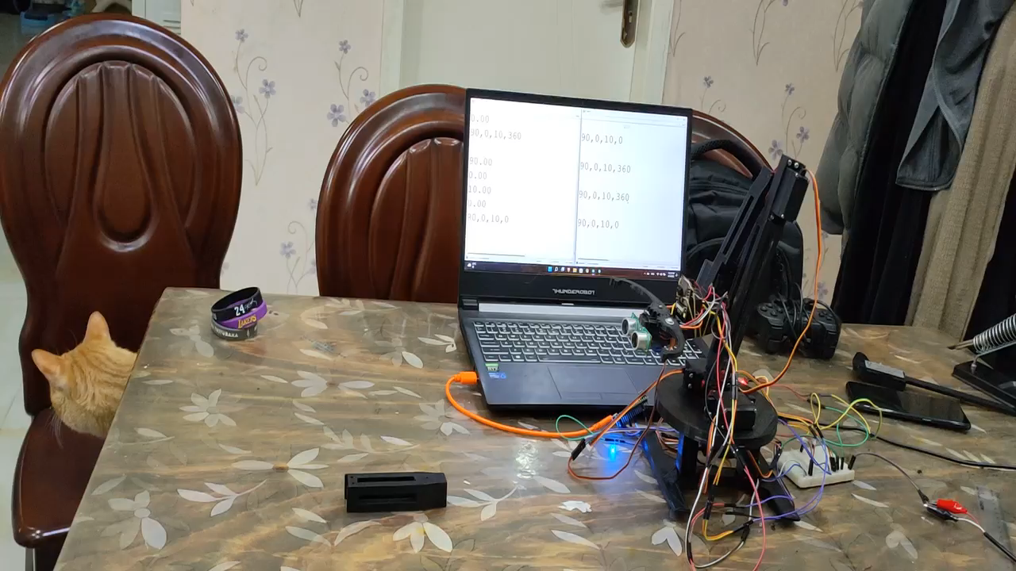
OUTLINE
CAD & 3D printing
MATLAB simulation
ARDUINO serial & servo control
Control software, results
& conclusions

Slide 3
Cad & 3d printing
ABIGABA PETER

Slide 4
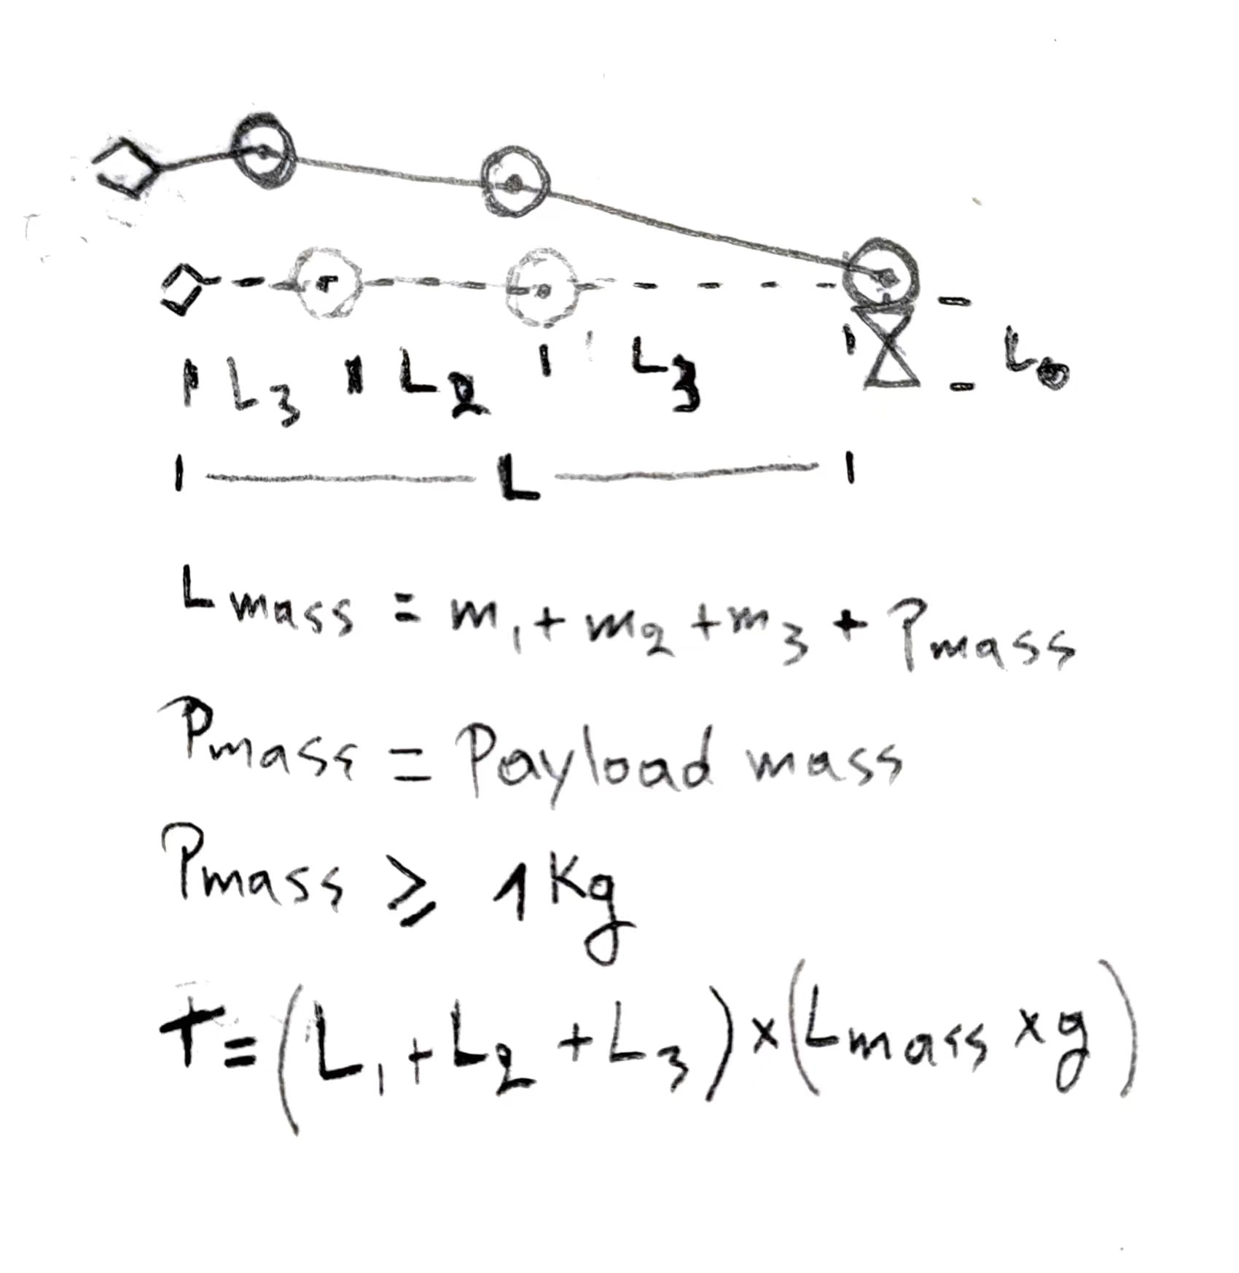
ROBOT DESIGN CONSIDERATIONS
It should lift 1 kg or more at the end effector and figure out where that object is on it’s own.
It should use servo motors for ease of control
It should be fully 3D printed except for nuts, bolts and bearings
After this, we assumed various lengths we would want the robot to have and their estimated masses (using Solidworks mass properties) and after a few iterations we saw that a torque of 40kg.cm would be enough to lift 1 kg for a >30cm arm length

Slide 5
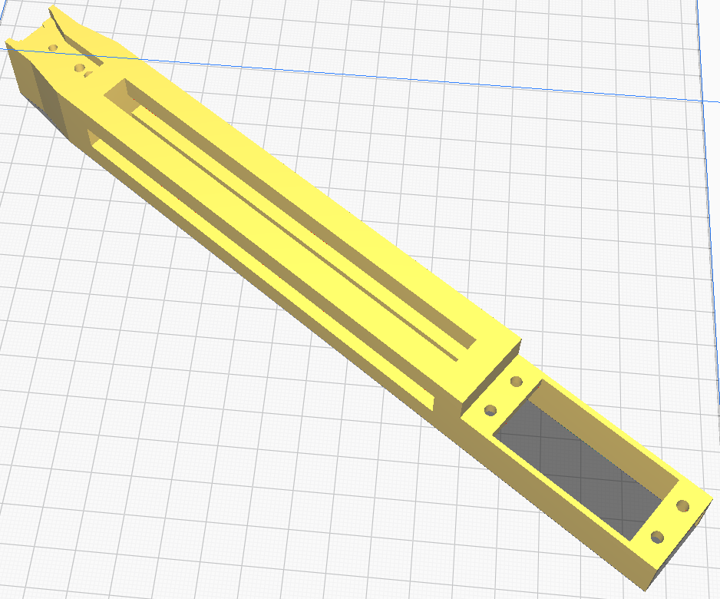
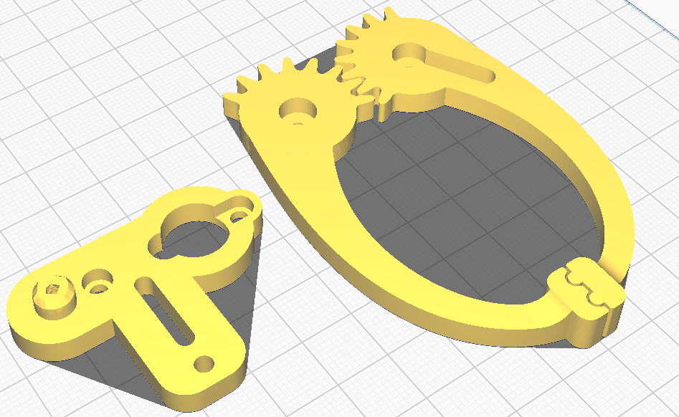
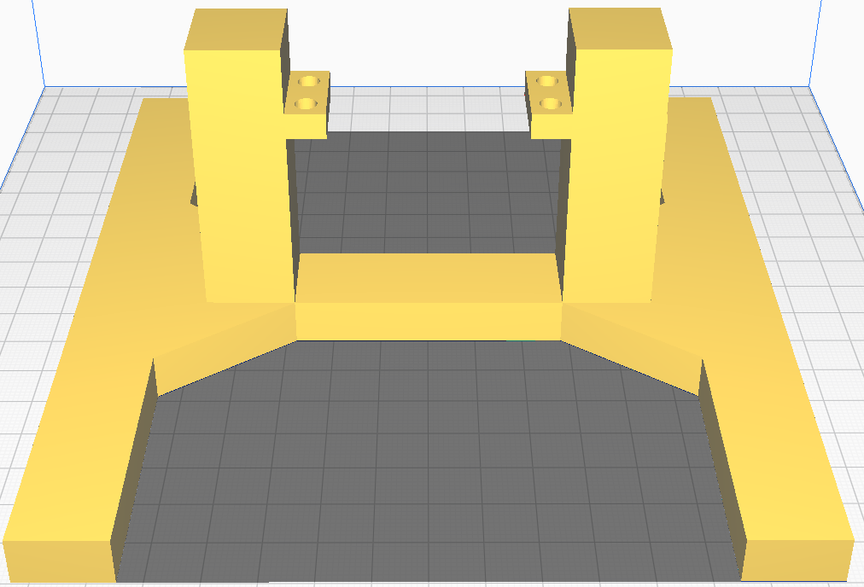
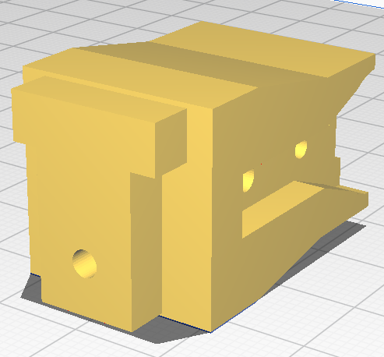
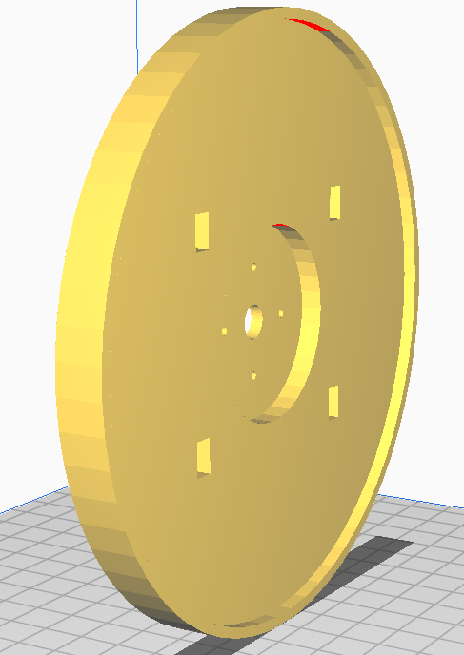
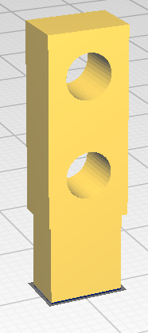
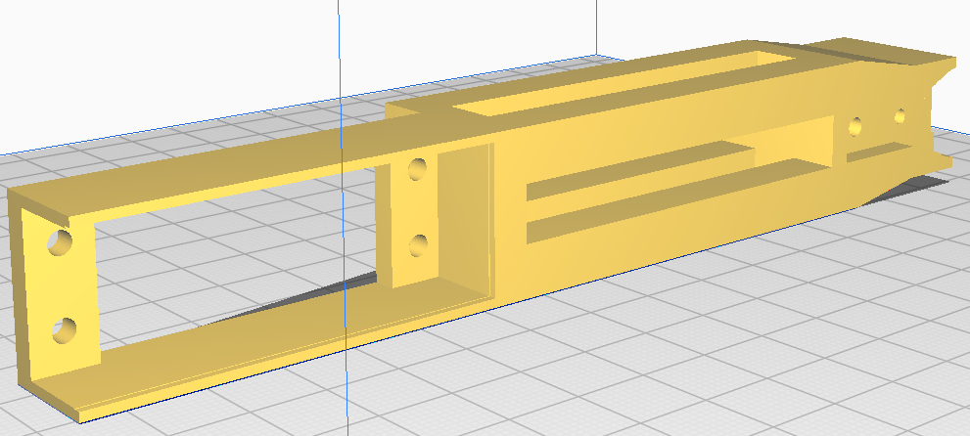
the Cad designs
Gripper
base
Shoulder arm
4x Servo mount
Upper base
Elbow arm
Wrist arm

Slide 6
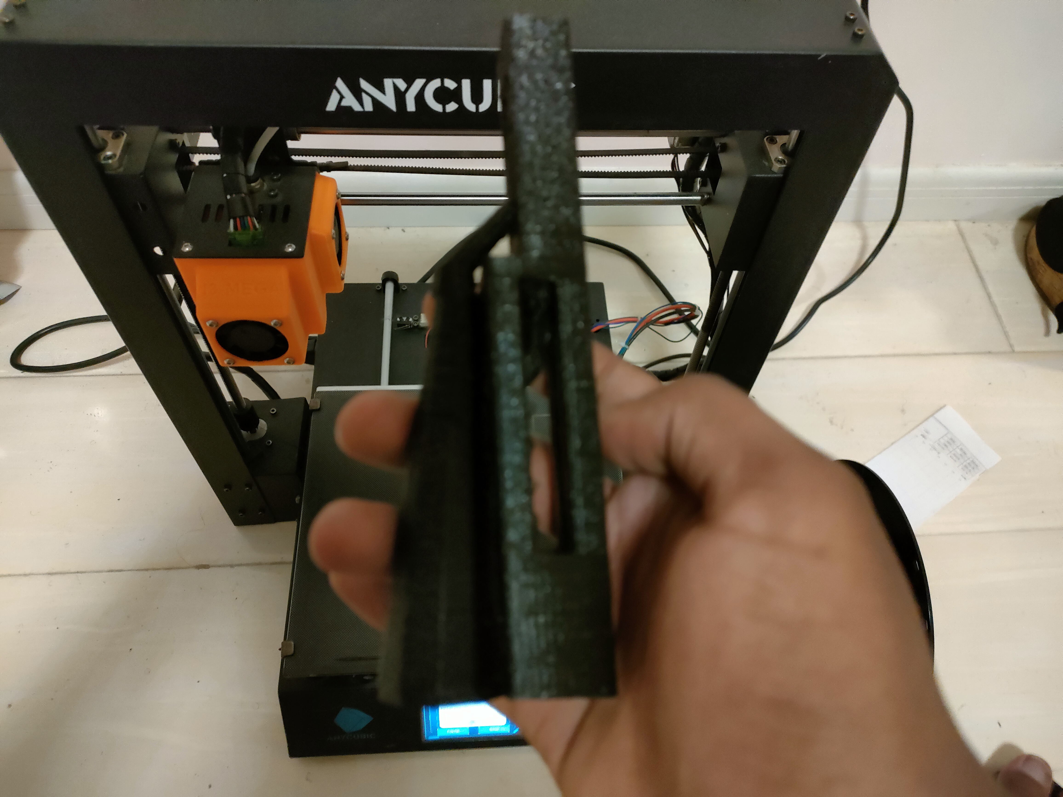
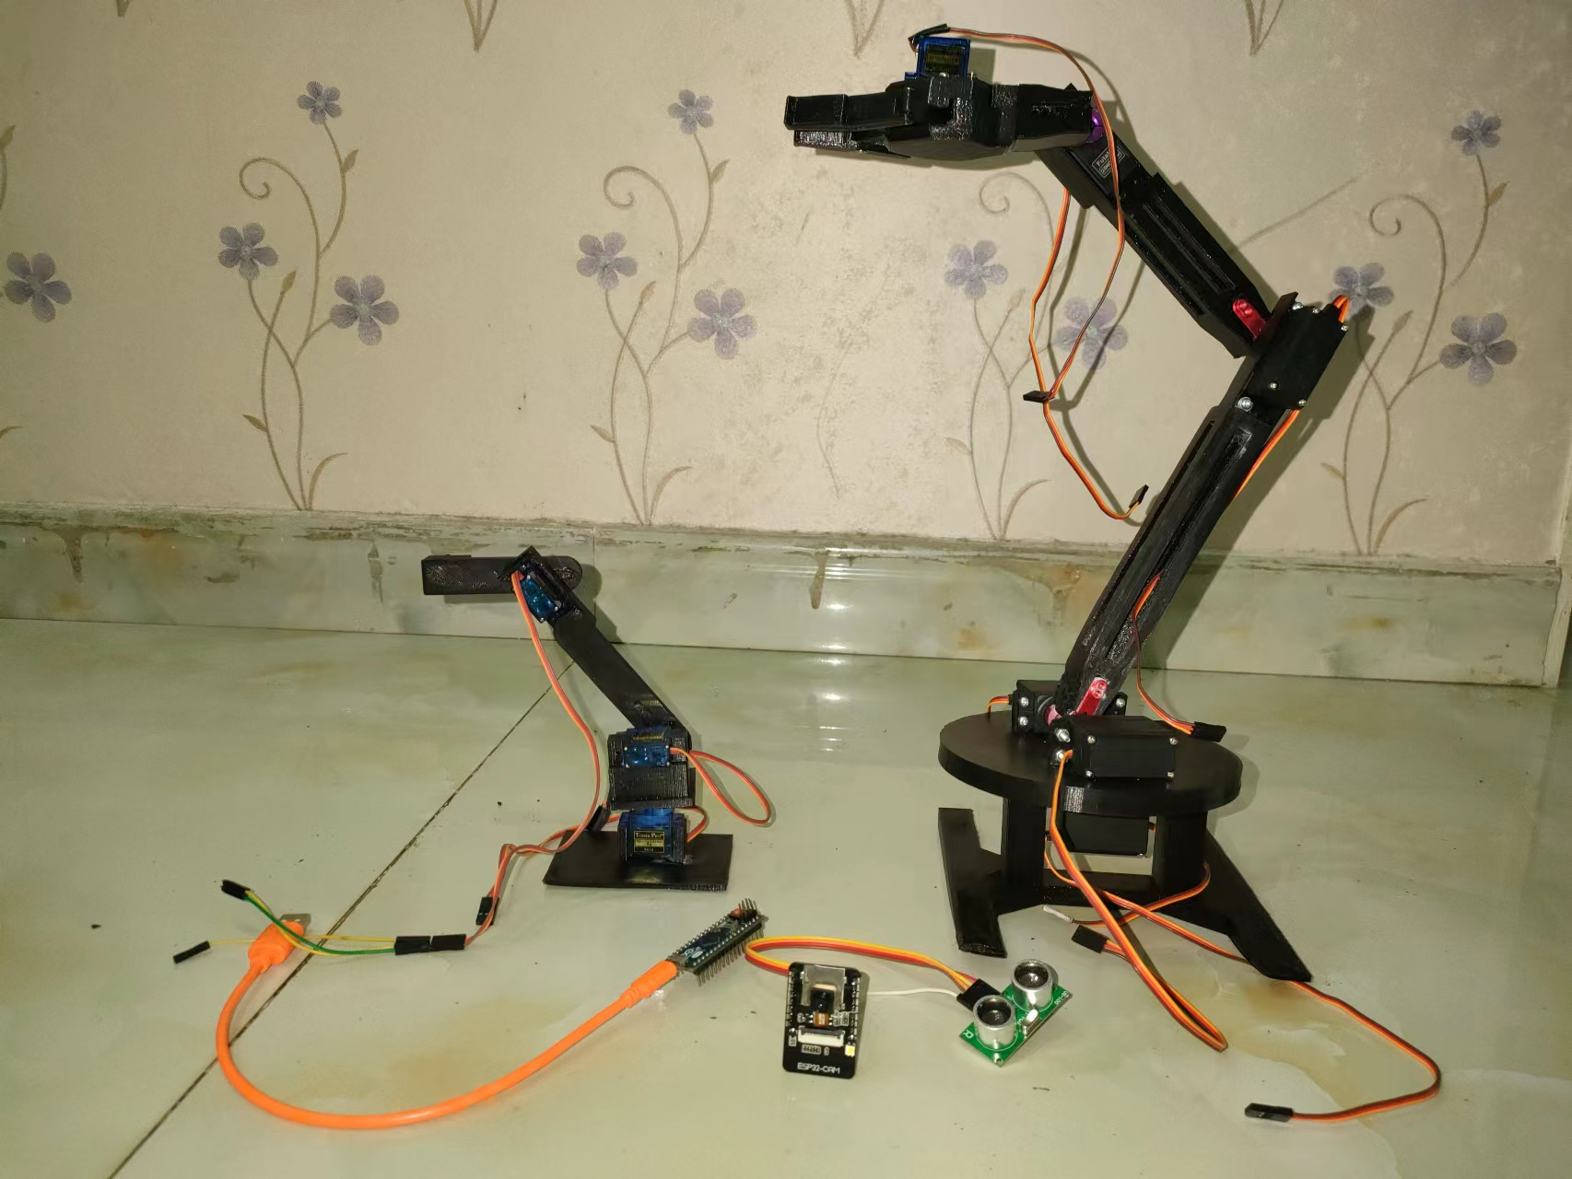
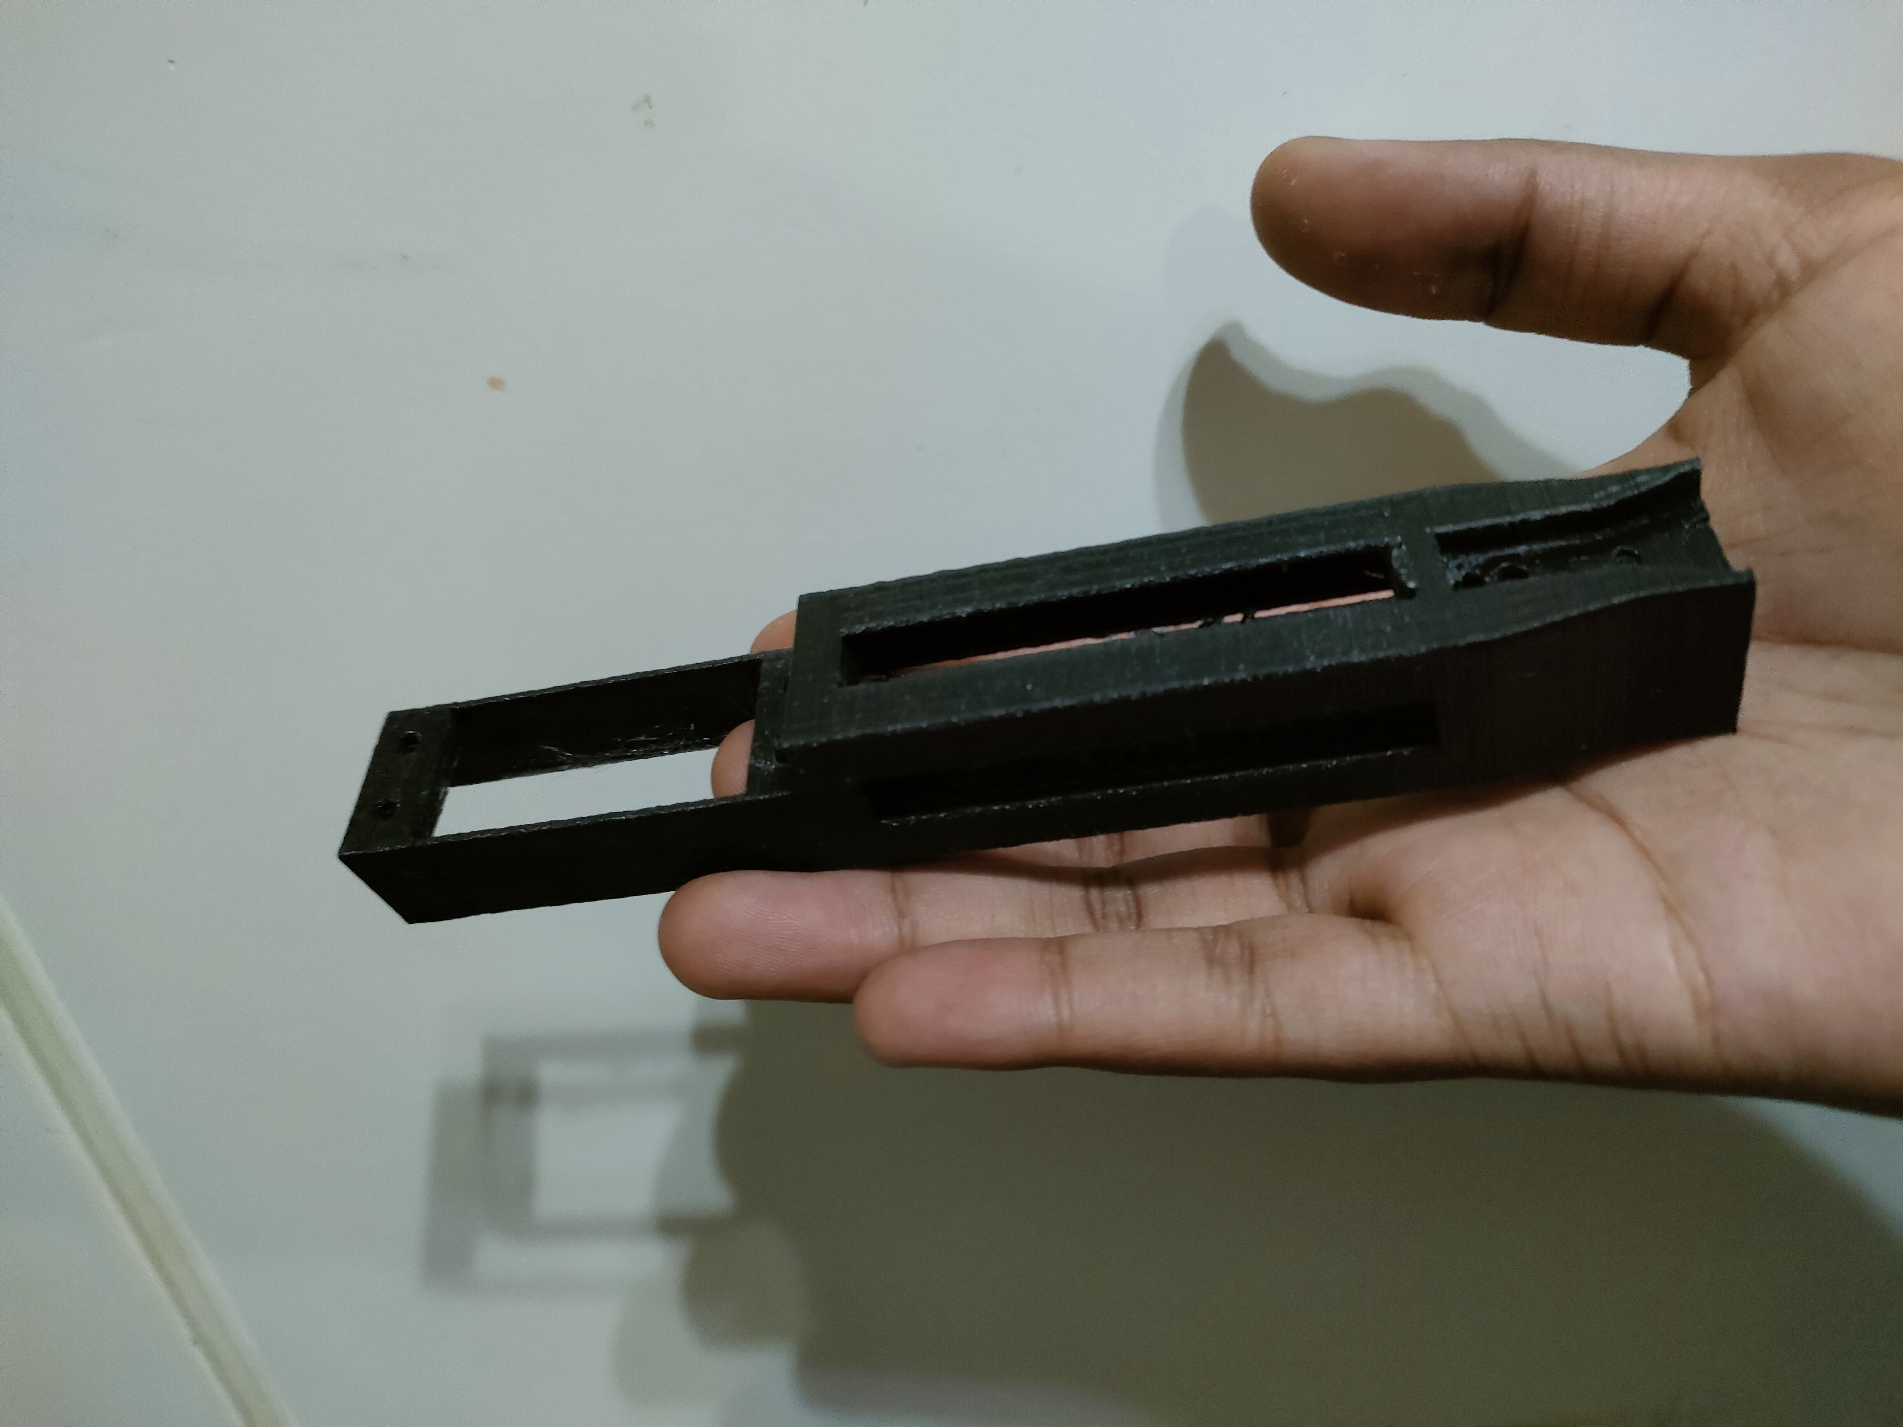
3d PRINTING AND ASSEMBLY
ELBOW ARM JUST PRINTED
ARM FULLY ASSEMBLED(the small arm is a test 2DOF arm)
AFTER REMOVING SUPPORTS

Slide 7
MATLAB SIMULATION
MISGANA DERIBACHEW

Slide 8
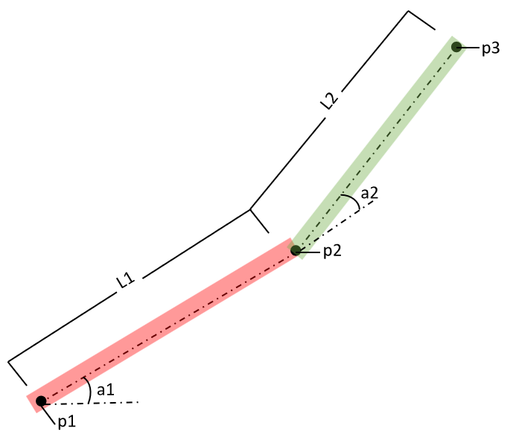
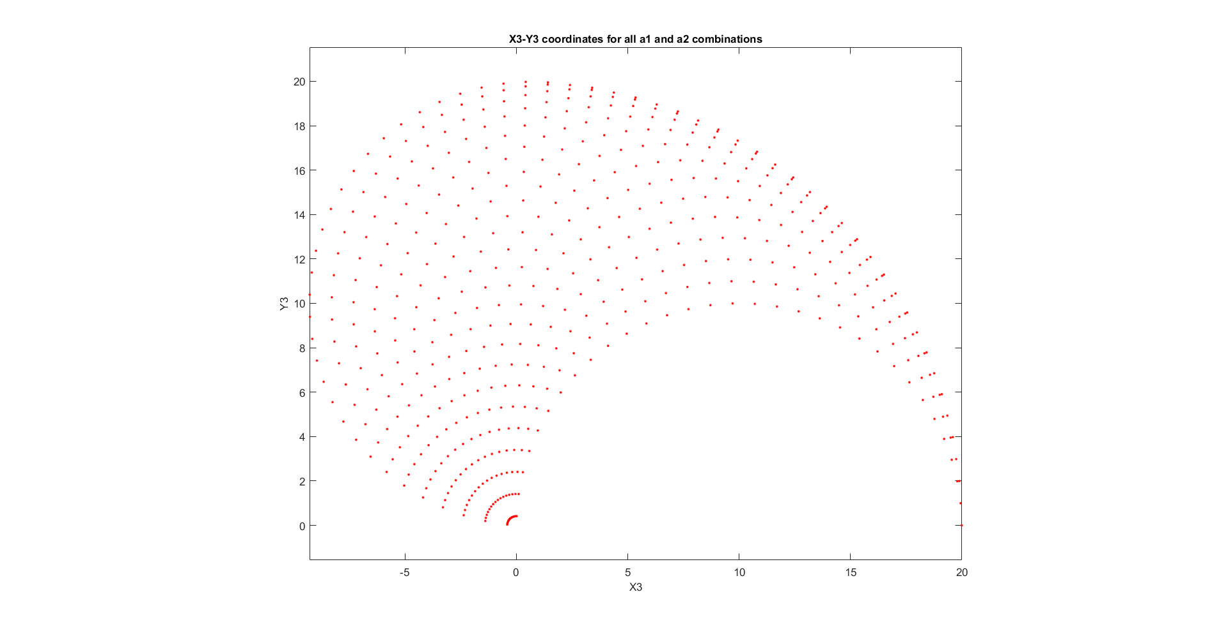
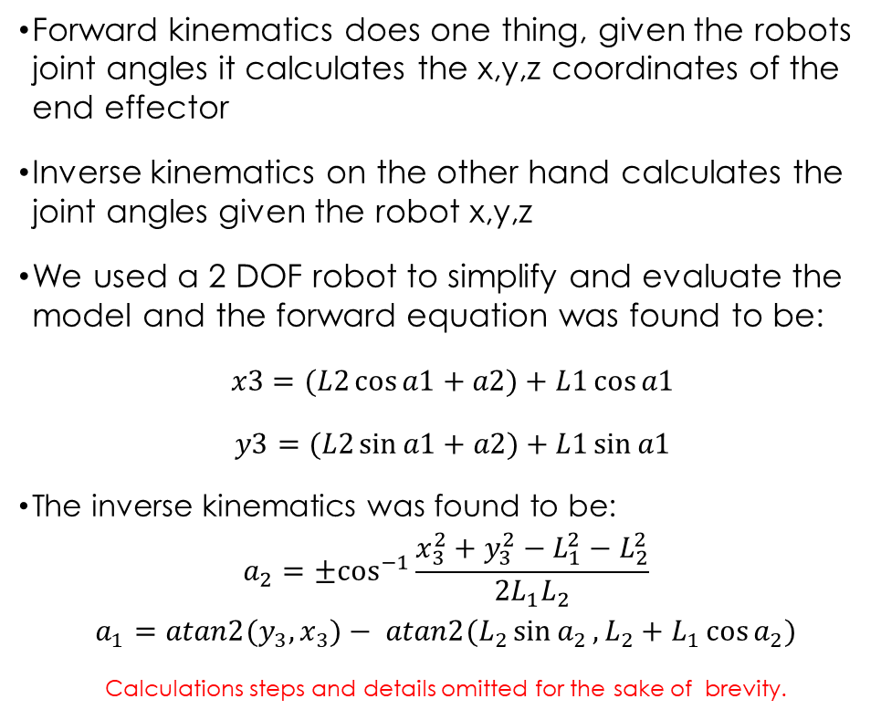
FORWARD and INVERSE KINEMATICS ROBOT MODEL
Forward kinematics does one thing, given the robots joint angles it calculates the x,y,z coordinates of the end effector
Inverse kinematics on the other hand calculates the joint angles given the robot x,y,z
We used a 2 DOF robot to simplify and evaluate the model and the forward equation was found to be:
$x3=(L2\cos{a1+a2)+L1\cos{a1}}$
$y3=(L2\sin{a1+a2)}+L1\sin{a1}$
The inverse kinematics was found to be:
$$a_{2}={±cos}^{−1}{\frac{x_{3}^{2}+y_{3}^{2}−L_{1}^{2}−L_{2}^{2}}{2L_{1}L_{2}}}$$
$$a_{1}=atan2(y_{3}{,x_{3})− atan2{(L_{2}\sin{a_{2}},L_{2}+L_{1}\cos{a_{2}}})}$$
Calculations steps and details omitted for the sake of brevity.
Arm diagram
All possible location the end effector can be

Slide 9
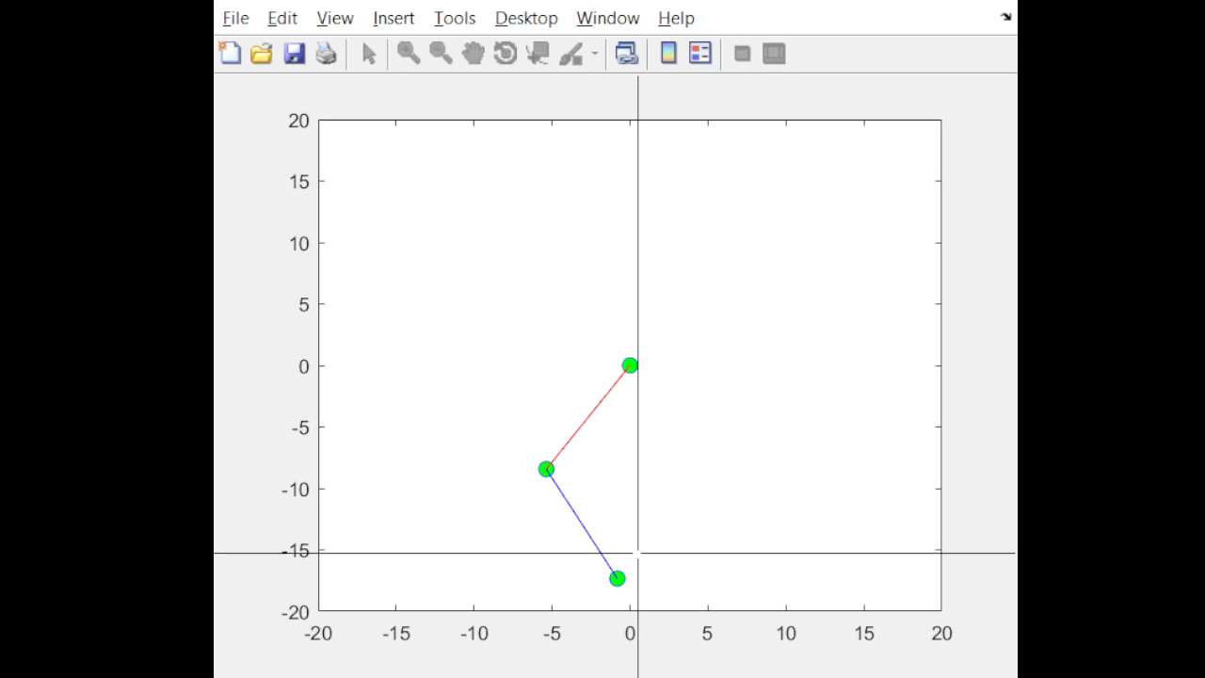
SIMULATION RESULTS

Slide 10
ARDUINO SERIAL&SERVO CONTROL
NDIZIHIWE JEAN PAUL

Slide 11
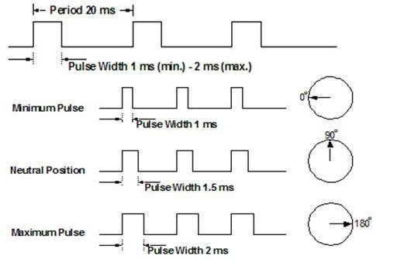
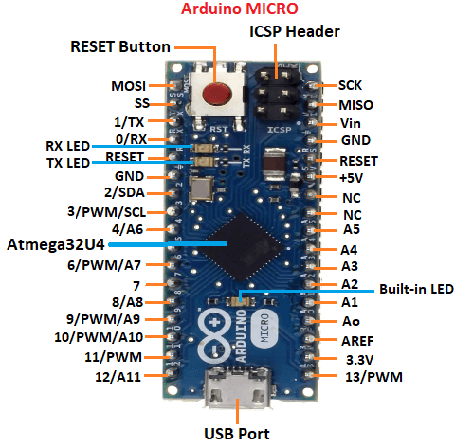
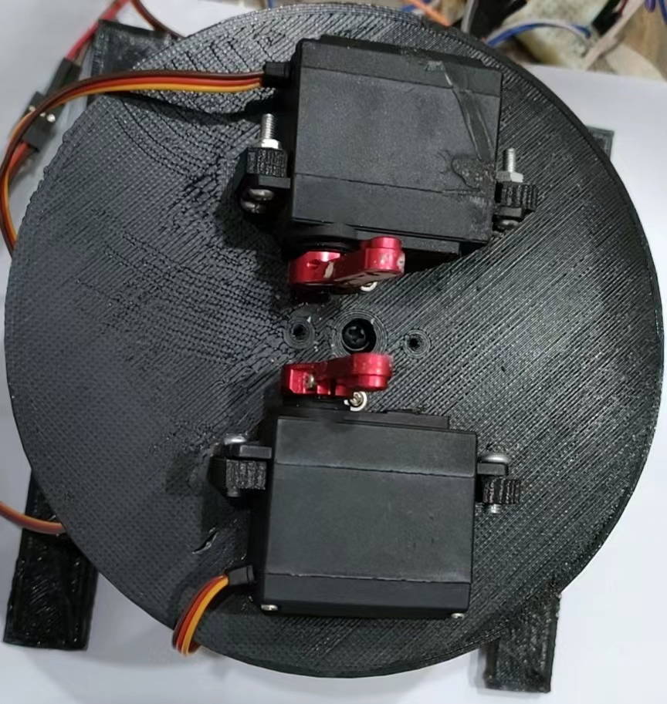
Arduino Servo Control
We used 4 futaba 20 kg servos, 1 mg995 servo for the base and 1 sg90 servo for the gripper
At the base we used 2 futaba 20kg.cm servos to reach the required 40kg.cm torque and we find out that they had to be offset by 180 degrees to make them move together.
We used Arduino’s servo library to control the servos
When the esp32 sends rotation angle
As 360 we retain the angle we are on
PWM signal sent to the servos
2 Servos at the base that should move together

Slide 12
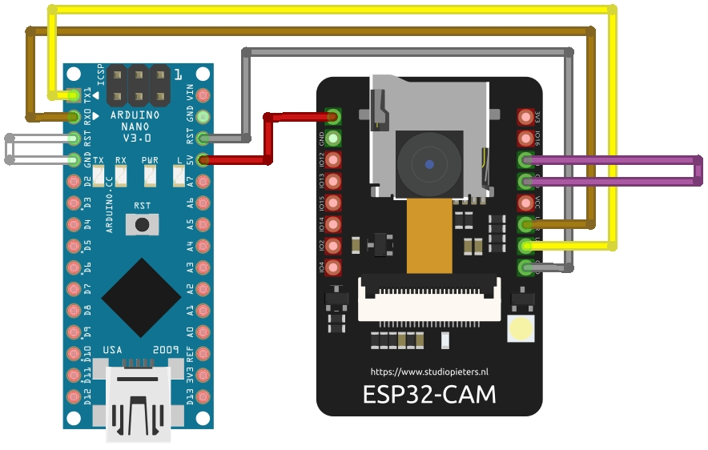
Arduino Serial Control
We need a 2 pins for an ultrasonic range sensor, and 6 for the servos, and perhaps a camera, so we chose the control board to be an esp32-cam running at 240 Mhz with 4 MB flash but the esp32-cam has a few usable pins, so we decided to use an Arduino micro to control the servos and get command from the esp32-cam over serial.
We run a loop that check if the esp32-cam sent data and the parse it as follows
Input from esp32-cam: 90.0,0.0,10.5,0.0\n
Use strtok to split input where char is “,” or “\n” into 4 substrings ( shoulder, elbow, wrist and base angles )
Then use atoi to make the substrings into float
And send those to the servos
ESP32-CAM connected to an Arduino Micro over serial

Slide 13
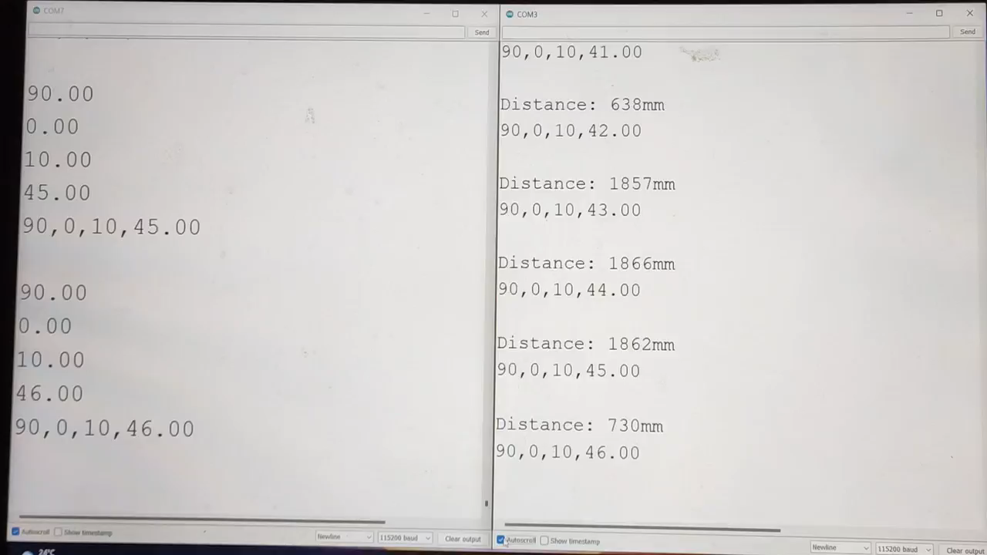
ESP32-CAM COMMUNICATION TO THE ARDUINO MICRO OVER SERIAL

Slide 14
Control software and conclusions
Munyakabera jean claude

Slide 15
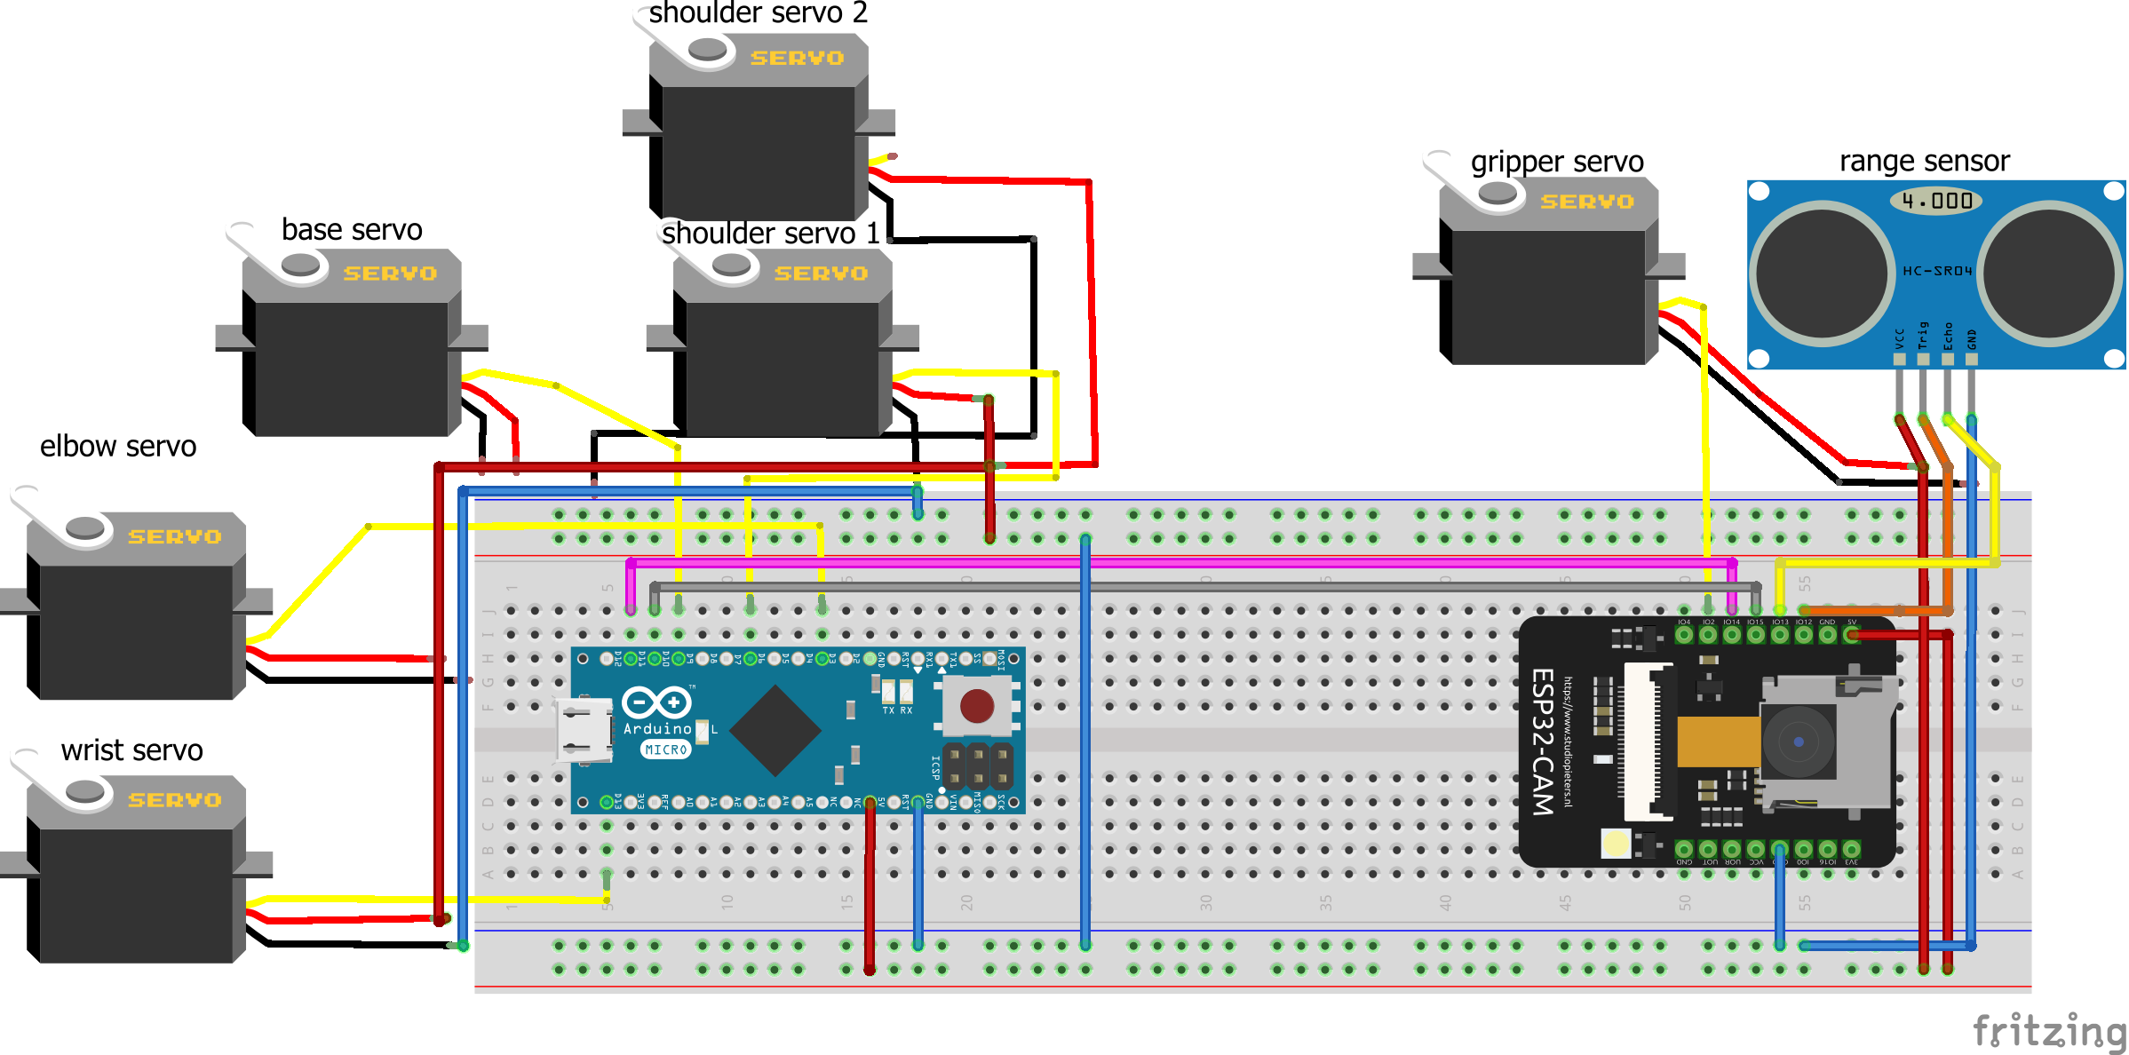
circuit
7.4v for the big servos on this side
5v for the rest on this side

Slide 16
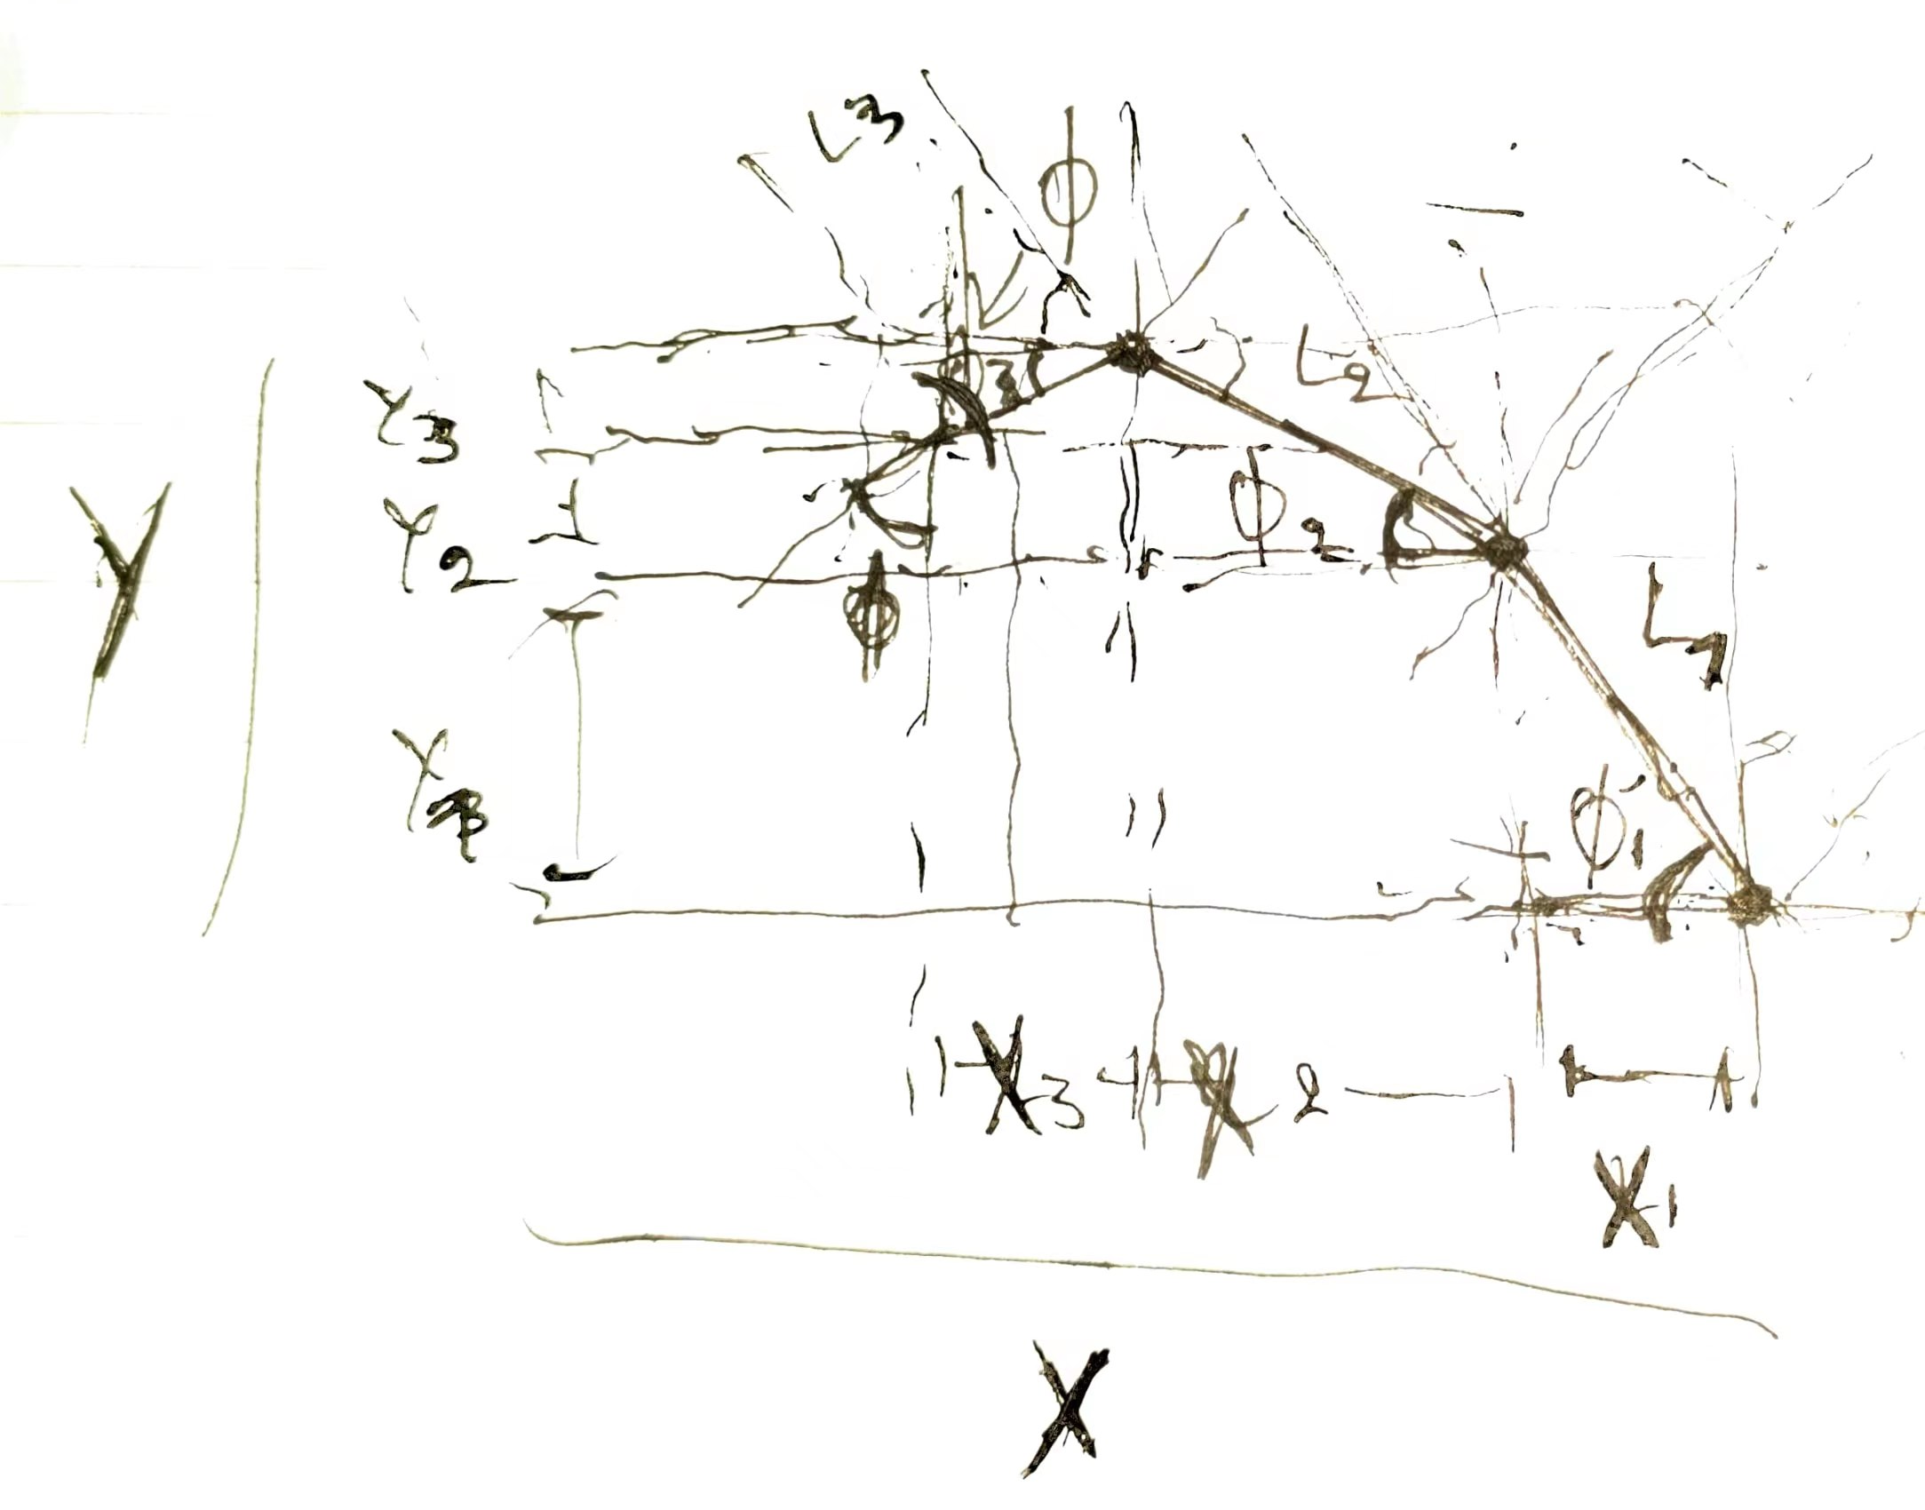
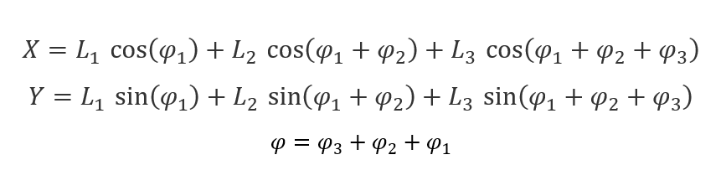
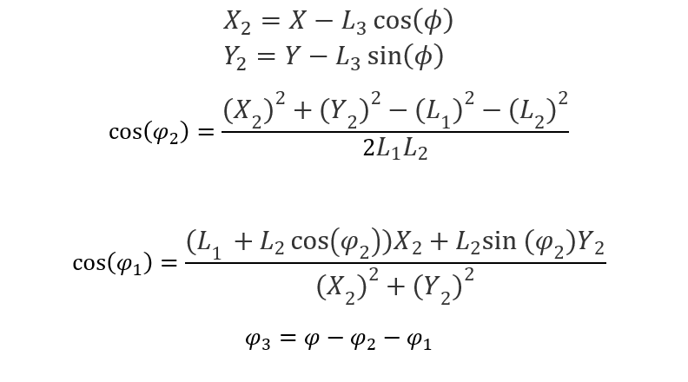
FORWARD and INVERSE KINEMATICS FAILED, NEW ALGORITHM NEEDED!
After many tests, inverse kinematics failed on both test and final robot arm, our own implementation worked in the simulator but failed on the robots, we tried various other libraries and they all failed (eg: fabrik2d), the issue being the servo angle configuration.
The new algorithm was made to be simple and straight forward it goes like:
given starting angles A1,A2,A3 and final angles A1’,A2’,A3’ with step T, take a reference joint then calculate the next step of the other joints relative to it, and iterate by T till you reach the final angles
The result of this, is the arm move in a straight line, the gripper always facing forward
3 dof Arm diagram
Forward kinematics
inverse kinematics

Slide 17
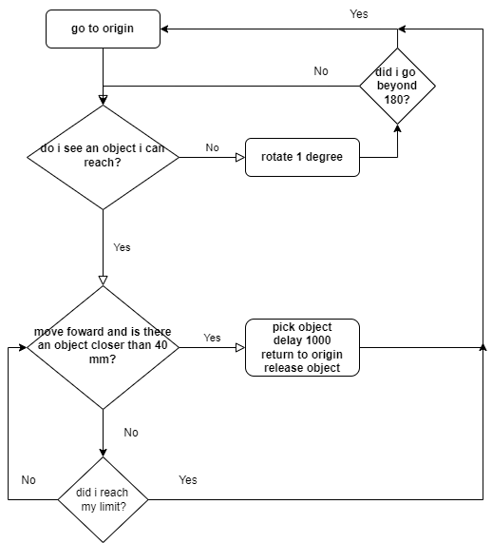
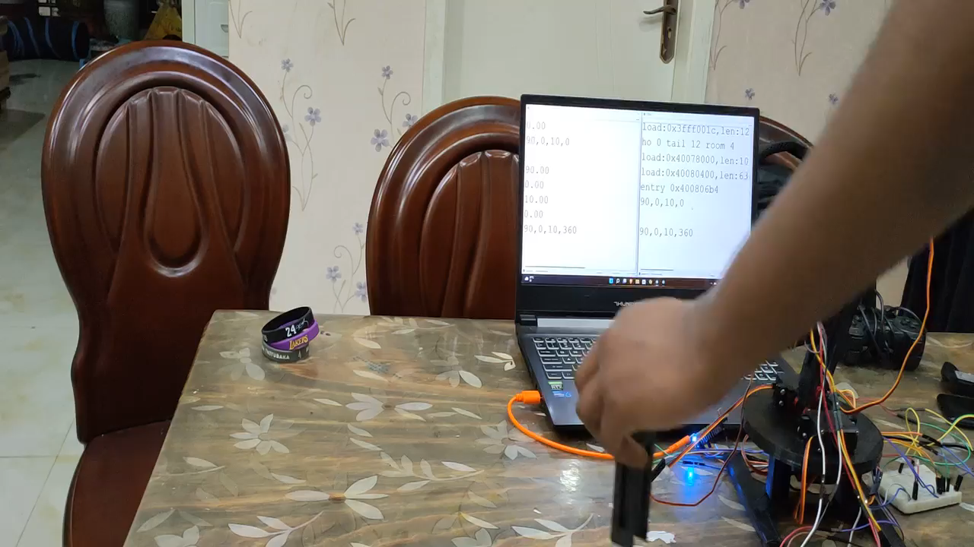
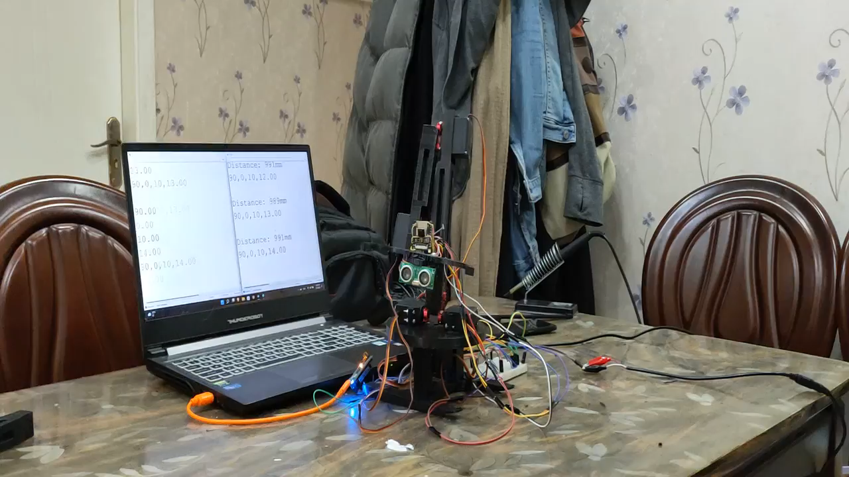
Control software
Moving forward
Main loop
Rotate searching for object

Slide 18
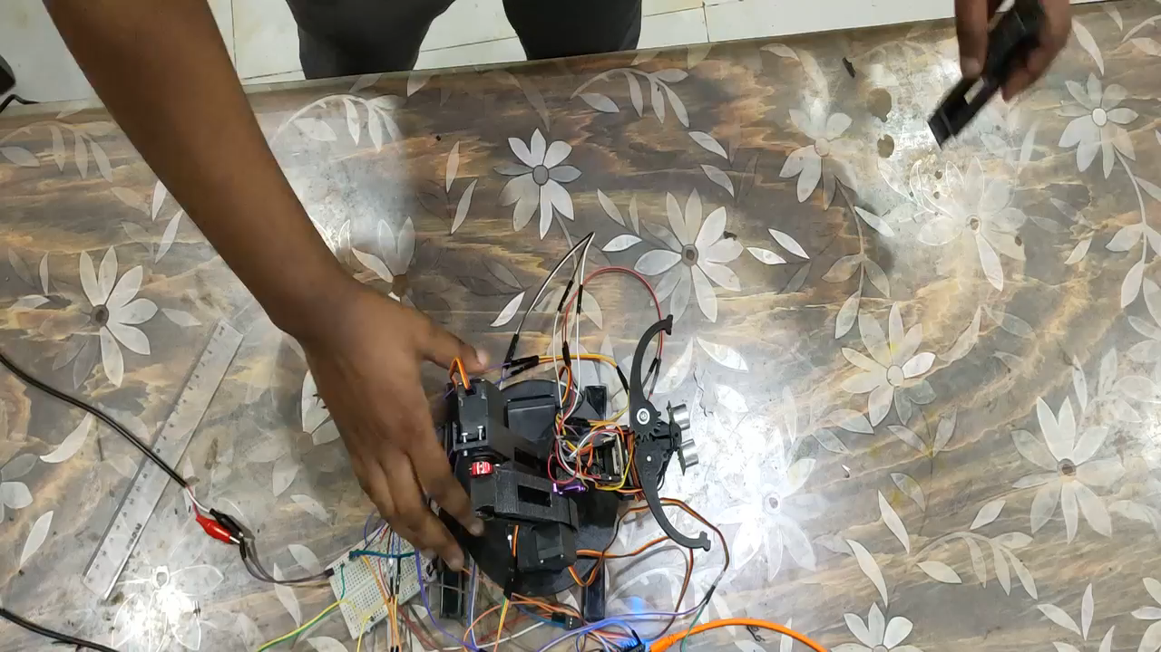
How far can it go?

Slide 19
Issues ,conclusions and future work
The issues that it has are many, it is not stable due to the mobile servo mounts, the base servo’s encoder is not very accurate to move at 1 degree increments(mg995), the algorithm used is very limited, the esp32 restarts most times when the gripper servo closes due to a current surge, the servos are not supported on both sides, the part that holds the servos are weak and break easily, the base cannot stay straight when the arm is fully extended, unmanaged wiring and more.
But it has and while we keep working on it will keep being a great learning tool, which we can keep iterating over and over learning new things while making it perform better.
To conclude it successfully but not efficiently achieved the task of automatically picking up objects by detecting where they are.
The future work is massive, as the issues are, not only will we fix the issues but also add more functionalities like using the camera, i2c and wireless capabilities of the esp32.

Slide 20
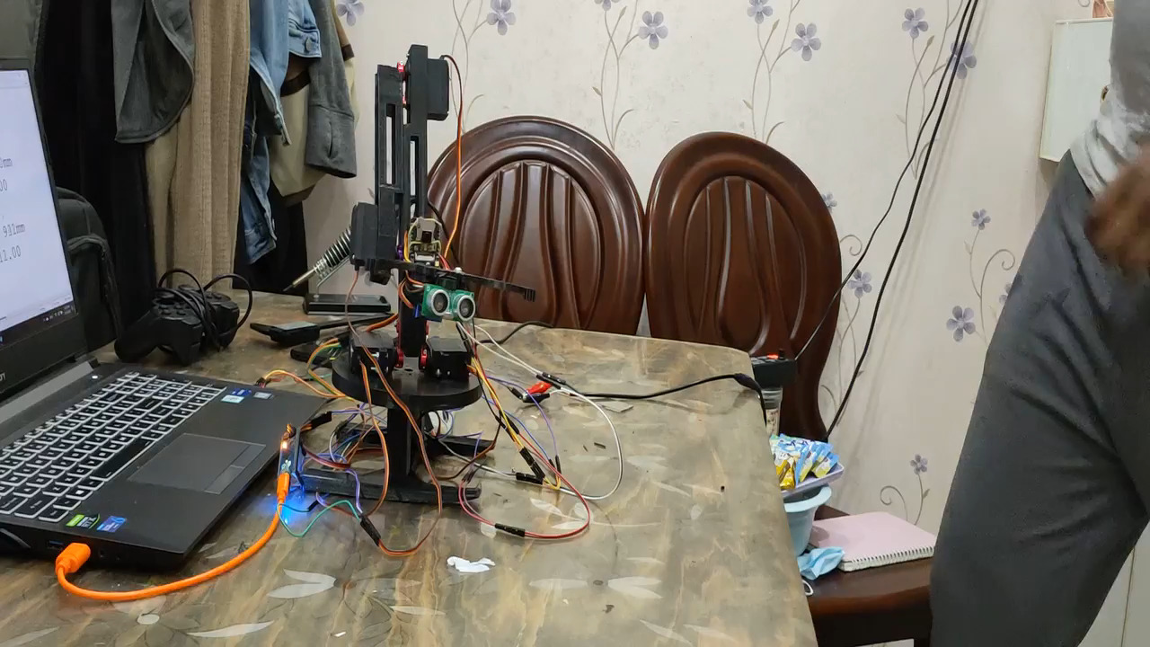
THE END

